Slide 1

Plan the analysis, sample size and sampling method Andrew Chapman SAS Coordinator

Slide 2
Planning Quantitative Analysis
Identify what statistical tests apply to your variables.
Estimate the effect-size expected in the RQ.
Estimate the minimum desirable sample size.
Consider how to avoid bias in your sampling method.

Slide 3

1. Tests?

Slide 4
Statistical tests?
What statistical methods test the evidence for the relationships in the RQs?
This depends on your sampling and data collection methods, and
The type of data that you have collected.
So you should consult a statistician during your planning.
Some suggested tests for common types of study and data can be found in the following tables:

Slide 5
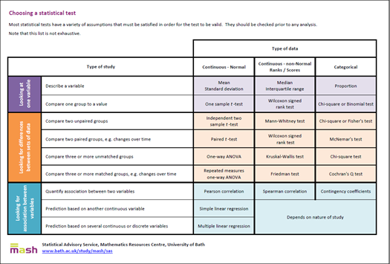
Tests for one variable

Slide 6
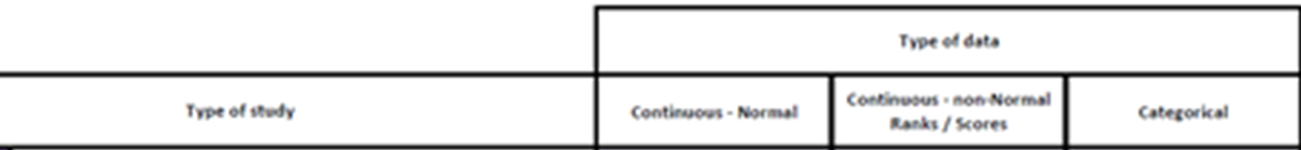
Testing for differences

Slide 7

Testing Associations

Slide 8


2. Effect Size

Slide 9
Effect Size ➔ Sample Size
When hunting for a mouse in a jungle
you need an army of observers
When hunting for an elephant in a jungle
you need fewer observers.
The number of observations you need in your sample depends how big is the effect size you seek.

Slide 10
Effect Size?
From your literature search (or pilot studies) how large is the “effect” in the RQ relationship: small-medium-large?
There are numerous ways to measure effect size depending on what statistical analysis is being performed.
Wikipedia gives a useful summary https://en.wikipedia.org/wiki/Effect_size.
A useful, online effect-size calculator can be found here
https://www.campbellcollaboration.org/research-resources/effect-size-calculator.html

Slide 11
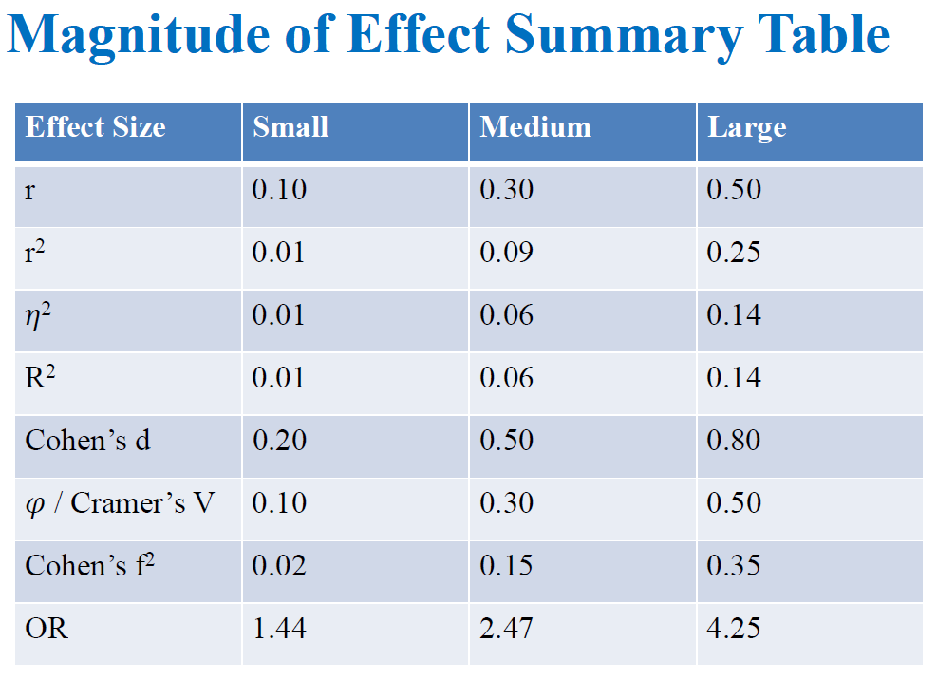
Small, Medium or Large?

Slide 12
Depends on test being used

Slide 13

3. Sample Size?

Slide 14
Estimating Sample Size?
Consult a statistician on how to use
“G*Power” free software for sample size calculations.
Together, you should produce a graph
showing the relationship between your estimated range of effect-sizes and the sample sizes needed.
The usual settings for power and significance are:
80% power with
5% significance level.

Slide 15
Power?
Statistical power is the probability that a random sample will detect an effect - if it truly exists in the population.
So 80% power means that a random sample would have a probability of 0.8 of detecting the effect that you are expecting in your research question.
A power of 80% also means that a random sample would have a probability of 0.2 of failing to detect a true effect in the population.
A larger sample gives a higher power (cf. mouse in jungle)

Slide 16
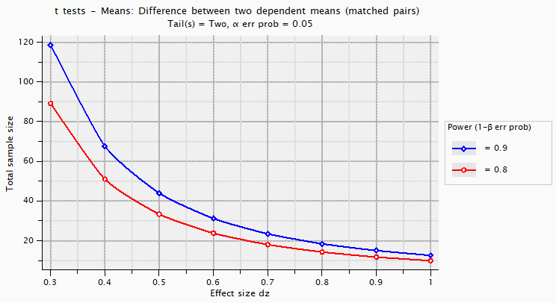
Sample Sizing Graph

Slide 17

4. Unbiased Sample?

Slide 18
Representative Sample?
How are you going to collect an adequate sample which represents your target population?
An introduction to alternative sampling methods here: https://www.qualtrics.com/uk/experience-management/research/sampling-methods/ https://www.scribbr.com/methodology/sampling-methods/
See the classic “Questionnaire Design, Interviewing and Attitude Measurement” by A.N.Oppenheim: Chapter 3.
See the modern and useful “Research Methods for Business Students” 8th edition by Saunders, Thornhill and Lewis.

Slide 19
Sampling Methods?
How-To-Recipes for sampling methods here:
https://www.questionpro.com/blog/quota-sampling/
https://www.questionpro.com/blog/cluster-sampling/
https://www.questionpro.com/blog/convenience-sampling/
https://www.questionpro.com/blog/probability-sampling/ .

Slide 20
All samples are biased?
Perfect random sampling is usually not feasible.
It will be useful to consider what possible subjects or items or observations have been systematically excluded by your method of sampling.
So you must plan to discuss how your sampling method has biased your results: for example by
Self-selection of respondents in on-line surveys.
Social exclusions due to snowball or convenience sampling.
Restriction of sampling to regions, areas or institutions.

Slide 21
the analysis, sample size and sampling method Andrew Chapman SAS Coordinator

